Slide 1




Bowling Game Kata
Object Mentor, Inc.
www.objectmentor.com
blog.objectmentor.com
fitnesse.org
www.junit.org
Copyright © 2005 by Object Mentor, Inc
All copies must retain this page unchanged.

Slide 2
What is this lesson?
Abbreviated version of the Bowling Kata
  Only Kata 1 & 2
  Full lesson is 5 Kata’s and about 1 hour

Slide 3
What will I learn?
Fundamentals of Test Driven Development
Some basics of Clean Code
How to score a bowling game.

Slide 4
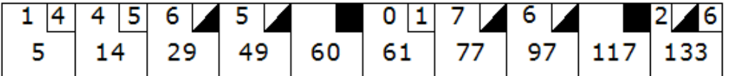
Scoring Bowling.
The game consists of 10 frames as shown above. In each frame the player has
two opportunities to knock down 10 pins. The score for the frame is the total
number of pins knocked down, plus bonuses for strikes and spares.
A spare is when the player knocks down all 10 pins in two tries. The bonus for
that frame is the number of pins knocked down by the next roll. So in frame 3
above, the score is 10 (the total number knocked down) plus a bonus of 5 (the
number of pins knocked down on the next roll.)

Slide 5
Scoring Bowling.
A strike is when the player knocks down all 10 pins on his first try. The bonus
for that frame is the value of the next two balls rolled.
In the tenth frame a player who rolls a spare or strike is allowed to roll the extra
balls to complete the frame. However no more than three balls can be rolled in
tenth frame.

Slide 6
Scoring Bowling.
A gutter game would consist of 20 rolls with each roll knocking down 0 (zero) pins
A perfect game the highest possible score is 300, achieved by bowling 12 strikes
in a row in a traditional single game: one strike in each of the first nine frames,
and three more in the tenth frame.

Slide 7

The Requirements.
Write a class named “Game” that has two methods
  roll(pins : int) is called each time the player rolls a ball. The argument is the number of pins knocked down.
  score() : int is called only at the very end of the game. It returns the total score for that game.

Slide 8

A quick design session
Clearly we need the Game class.

Slide 9
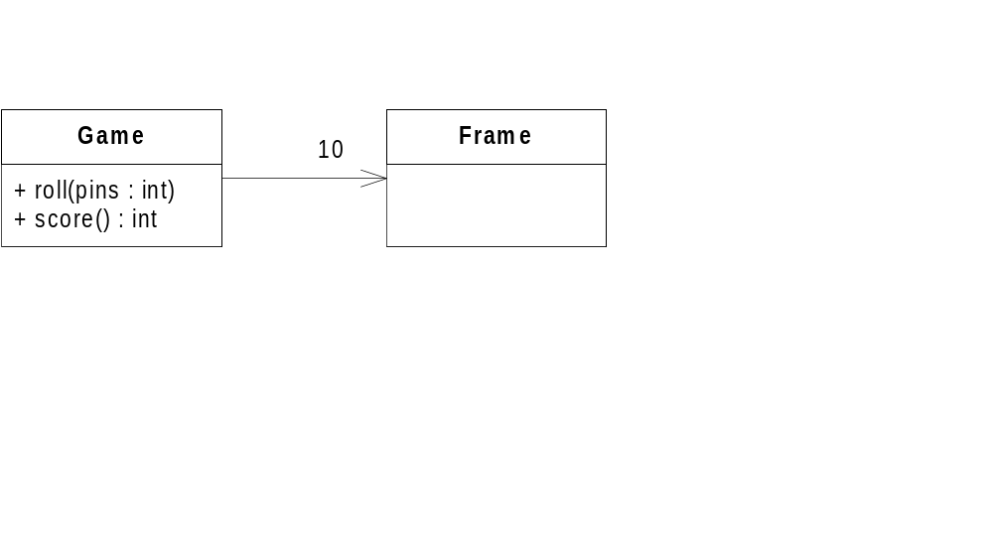
A quick design session
A game has 10 frames.

Slide 10

A quick design session
A frame has 1 or two rolls.

Slide 11

A quick design session
The tenth frame has two or three rolls.
It is different from all the other frames.

Slide 12

A quick design session
The score function must
iterate through all the
frames, and calculate
all their scores.

Slide 13

A quick design session
The score for a spare or a strike depends on the frame’s successor

Slide 14
Begin.
Create a project named BowlingGame
Create a unit test named BowlingGameTest
import org.junit.jupiter.api.Test;
import static org.junit.jupiter.api.Assertions.assertNotNull;
public class BowlingGameTest {
}

Slide 15
The zeroth test Kata
TEST
CLASS
public class BowlingGameTest {
@Test
public void testNewGame() {
Game g = new Game();
assertNotNull(g);
}
}

Slide 16
The zeroth test Kata
TEST
CLASS
public class BowlingGameTest {
@Test
public void testNewGame() {
Game g = new Game();
assertNotNull(g);
}
}
This will fail to run. Why?

Slide 17
Lesson Point 0.
Always create the test cases first
First test will always fail

Slide 18
The first test Kata
TEST
CLASS
public class BowlingGameTest {
@Test
public void testNewGame() {
Game g = new Game();
assertNotNull(g);
}
}
public class Game {
}

Slide 19

The first test Kata
TEST
CLASS
public class BowlingGameTest {
@Test
public void testNewGame() {
Game g = new Game();
assertNotNull(g);
}
}
public class Game {
}
THERE IS NO BAR

Slide 20
The first test Kata
TEST
CLASS
@Test
public void testNewGame() {
Game g = new Game();
assertNotNull(g);
}
@Test
public void testGutterGame() {
Game g = new Game();
for (int i = 0; i < 20; i++) {
g.roll(0);
}
}
public class Game {
public void roll(int pins) {
}
}

Slide 21
The first test Kata
TEST
CLASS
@Test
public void testNewGame() {
Game g = new Game();
assertNotNull(g);
}
@Test
public void testGutterGame() {
Game g = new Game();
for (int i = 0; i < 20; i++) {
g.roll(0);
}
assertEquals(0, g.score())
}
public class Game {
public void roll(int pins) {
}
public int score() {
return -1;
}
}

Slide 22
The first test Kata
TEST
CLASS
@Test
public void testNewGame() {
Game g = new Game();
assertNotNull(g);
}
@Test
public void testGutterGame() {
Game g = new Game();
for (int i = 0; i < 20; i++) {
g.roll(0);
}
assertEquals(0, g.score())
}
public class Game {
public void roll(int pins) {
}
public int score() {
return -1;
}
}
org.opentest4j.AssertionFailedError:
Expected :0
Actual :-1
<Click to see difference>

Slide 23
The first test Kata
TEST
CLASS
@Test
public void testNewGame() {
Game g = new Game();
assertNotNull(g);
}
@Test
public void testGutterGame() {
Game g = new Game();
for (int i = 0; i < 20; i++) {
g.roll(0);
}
assertEquals(0, g.score())
}
public class Game {
public void roll(int pins) {
}
public int score() {
return 0;
}
}
Process finished with exit code 0

Slide 24
Lesson Point 1.
Test one scenario at a time
Design iteratively. (including the tests)

Slide 25
The second test Kata
TEST
CLASS
@Test
public void testNewGame() {
Game g = new Game();
assertNotNull(g);
}
@Test
public void testGutterGame() {
Game g = new Game();
for (int i = 0; i < 20; i++) {
g.roll(0);
}
assertEquals(0, g.score())
}
@Test
public void testAllOnes() {
Game g = new Game();
for (int i = 0; i < 20; i++)
g.roll(1);
assertEquals(20, g.score());
}
public class Game {
public void roll(int pins) {
}
public int score() {
return 0;
}
}

Slide 26
The second test Kata
TEST
CLASS
@Test
public void testNewGame() {
Game g = new Game();
assertNotNull(g);
}
@Test
public void testGutterGame() {
Game g = new Game();
for (int i = 0; i < 20; i++) {
g.roll(0);
}
assertEquals(0, g.score())
}
@Test
public void testAllOnes() {
Game g = new Game();
for (int i = 0; i < 20; i++)
g.roll(1);
assertEquals(20, g.score());
}
public class Game {
public void roll(int pins) {
}
public int score() {
return 0;
}
}
expected:<20> but was:<0>

Slide 27
Lesson Point 2.
Keep it DRY
(Yes, you can refactor tests)

Slide 28
The second test Kata
- Game creation is duplicated
- roll loop is duplicated
TEST
CLASS
@Test
public void testNewGame() {
Game g = new Game();
assertNotNull(g);
}
@Test
public void testGutterGame() {
Game g = new Game();
for (int i = 0; i < 20; i++) {
g.roll(0);
}
assertEquals(0, g.score())
}
@Test
public void testAllOnes() {
Game g = new Game();
for (int i = 0; i < 20; i++)
g.roll(1);
assertEquals(20, g.score());
}
public class Game {
public void roll(int pins) {
}
public int score() {
return 0;
}
}

Slide 29
The second test Kata
- Game creation is duplicated
TEST
CLASS
public class BowlingGameTest {
private Game g;
@BeforeEach
void setUp() {
g = new Game();
}
public class Game {
public void roll(int pins) {
}
public int score() {
return 0;
}
}

Slide 30
The second test Kata
- Game creation is now ”before”
TEST
CLASS
@Test
public void testNewGame() {
assertNotNull(g);
}
@Test
public void testGutterGame() {
for (int i = 0; i < 20; i++) {
g.roll(0);
}
assertEquals(0, g.score());
}
@Test
public void testAllOnes() {
for (int i = 0; i < 20; i++)
g.roll(1);
assertEquals(20, g.score());
}
public class Game {
public void roll(int pins) {
}
public int score() {
return 0;
}
}

Slide 31
The second test Kata
- roll loop is duplicated
TEST
CLASS
@Test
public void testNewGame() {
assertNotNull(g);
}
@Test
public void testGutterGame() {
for (int i = 0; i < 20; i++) {
g.roll(0);
}
assertEquals(0, g.score());
}
@Test
public void testAllOnes() {
for (int i = 0; i < 20; i++)
g.roll(1);
assertEquals(20, g.score());
}
public class Game {
public void roll(int pins) {
}
public int score() {
return 0;
}
}

Slide 32
The second test Kata
- roll loop is duplicated
TEST
CLASS
private void rollMany(int rolls, int pins) {
for (int i = 0; i < rolls; i++)
g.roll(pins);
}
@Test
public void testGutterGame() {
  int rolls = 20;
  int pins = 0;
  rollMany(rolls, pins);
  assertEquals(0, g.score());
}
@Test
rollMany(rolls, pins);
assertEquals(20, g.score());
}
public class Game {
public void roll(int pins) {
}
public int score() {
return 0;
}
}

Slide 33
The second test Kata
TEST
CLASS
private void rollMany(int rolls, int pins) {
for (int i = 0; i < rolls; i++)
g.roll(pins);
}
@Test
public void testGutterGame() {
  int rolls = 20;
  int pins = 0;
  rollMany(rolls, pins);
  assertEquals(0, g.score());
}
@Test
rollMany(rolls, pins);
assertEquals(20, g.score());
}
public class Game {
public void roll(int pins) {
}
public int score() {
return 0;
}
}
expected:<20> but was:<0>

Slide 34
The second test Kata
TEST
CLASS
private void rollMany(int rolls, int pins) {
for (int i = 0; i < rolls; i++)
g.roll(pins);
}
@Test
public void testGutterGame() {
  int rolls = 20;
  int pins = 0;
  rollMany(rolls, pins);
  assertEquals(0, g.score());
}
@Test
rollMany(rolls, pins);
assertEquals(20, g.score());
}
private int score = 0;
public void roll(int pins) {
score += pins;
}
public int score() {
return score;
}

Slide 35
The second test Kata
TEST
CLASS
private void rollMany(int rolls, int pins) {
for (int i = 0; i < rolls; i++)
g.roll(pins);
}
@Test
public void testGutterGame() {
  int rolls = 20;
  int pins = 0;
  rollMany(rolls, pins);
  assertEquals(0, g.score());
}
@Test
rollMany(rolls, pins);
assertEquals(20, g.score());
}
private int score = 0;
public void roll(int pins) {
score += pins;
}
public int score() {
return score;
}

Slide 36
The third test Kata
We won’t have time for today.
Here’s the TLDR;

Slide 37
The third test Kata
This code is wrong
TEST
CLASS
private int score = 0;
public void roll(int pins) {
score += pins;
}
public int score() {
return score;
}

Slide 38
The third test Kata
Here is the test that proves it.
TEST
CLASS
@Test
public void testOneSpare() {
g.roll(5);
g.roll(5); // spare
g.roll(3);
rollMany(17,0);
assertEquals(16,g.score());
}
private int score = 0;
public void roll(int pins) {
score += pins;
}
public int score() {
return score;
}

Slide 39
What did we cover?
Write your tests first
One outcome at a time
Keep your code and your tests DRY

Slide 40

Questions?

Slide 41
End

